Slide 1
Weekly Report
Wensheng Cheng
2022.5.9-5.16

Slide 2
Last discussion
Extract box features from the trained detector, and take them as the node features.
All nodes are connected to others to form fully connected graph. Two consecutive frames are taken as inputs for now. Edge weights are the cos similarity between features of two nodes.
Loss A: for nodes with same labels of the template, make them also have similar graph embeddings with the template.
Result: didn’t work in principle, since the last classification layer would not be supervised in this way.
Loss B: for nodes with similar graph embeddings, make them have similar classification probability.
Result: could supervise the classification layer, but the graph embeddings of all nodes are already similar in the start.

Slide 3
This week
Test Label Propagation method to remove FP in detection results.
Result: Directly applying label propagation method didn’t work, since we only have one label, and the method would assign all samples the same label. Need to use special label propagations that can discover new class. But related ones didn’t provide public code for now.
I then test clustering methods to find FP detection results.
Result: To my surprise, k-means can already get fairly good performance on the seqs I tested. I think the main reason is the target objects are similar in appearance, and it’s easy for the clustering method to distinguish them from other FPs.

Slide 4
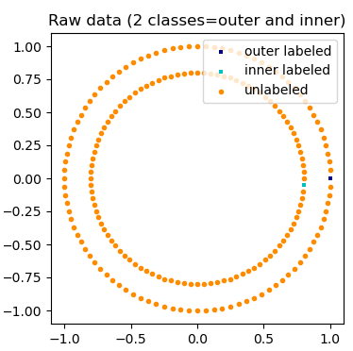
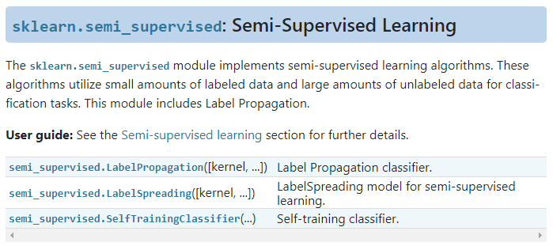
Label Propagation
Label propagation aims to get labels of unlabeled samples based on those samples with given label. It’s in fact a semi-supervised method.
SKLearn tutorial

Slide 5
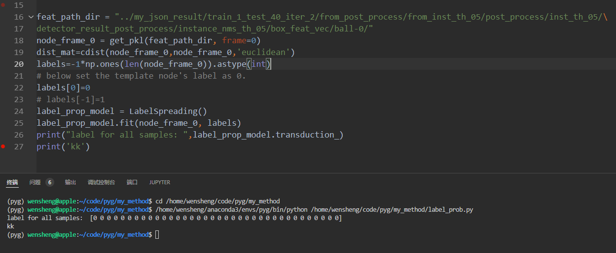
Label Propagation
Directly using label propagation would assign all samples the same label of the template. Below all samples get the same label(0) with the template one using label propagation method.
Label propagation output

Slide 6
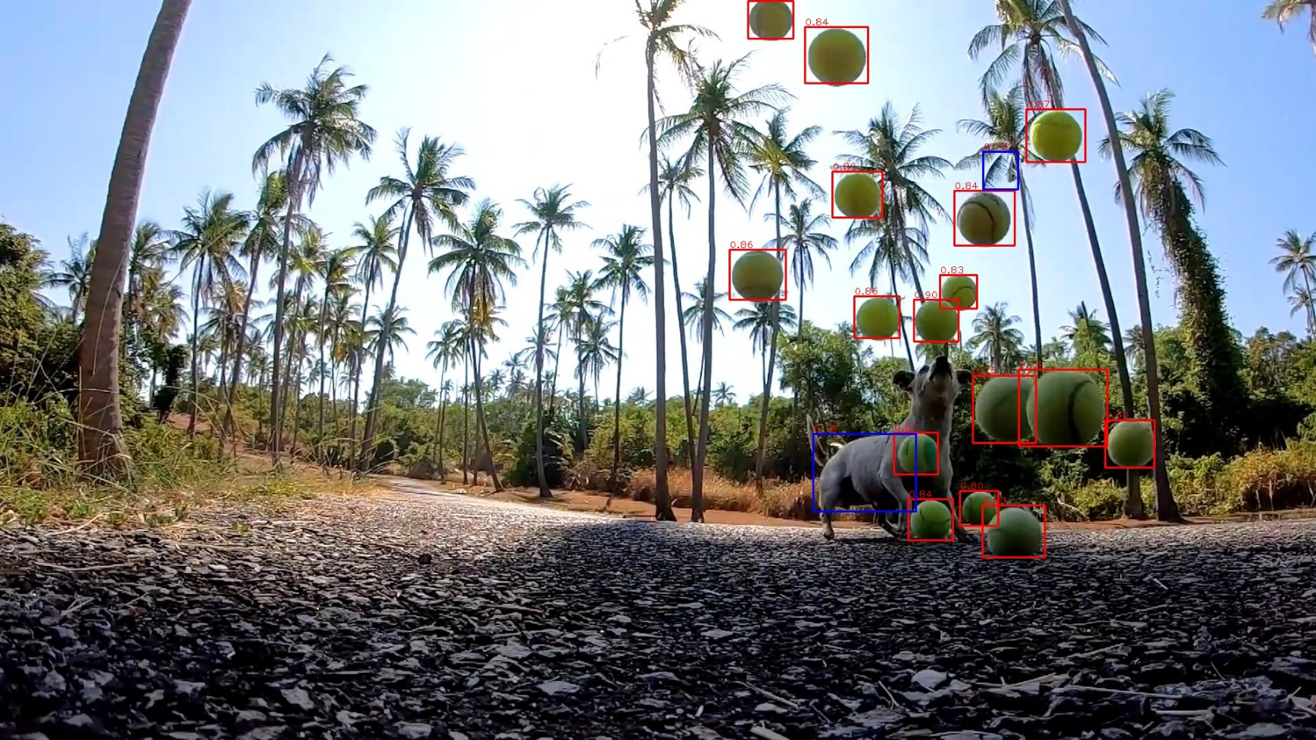
Clustering
I then think about the setting, and feel clustering is worth a try.
K means with K=2 is used.
Ori

Slide 7
Clustering
I then think about the setting, and feel clustering is worth a try.
K means with K=2 is used.
Pred

Slide 8
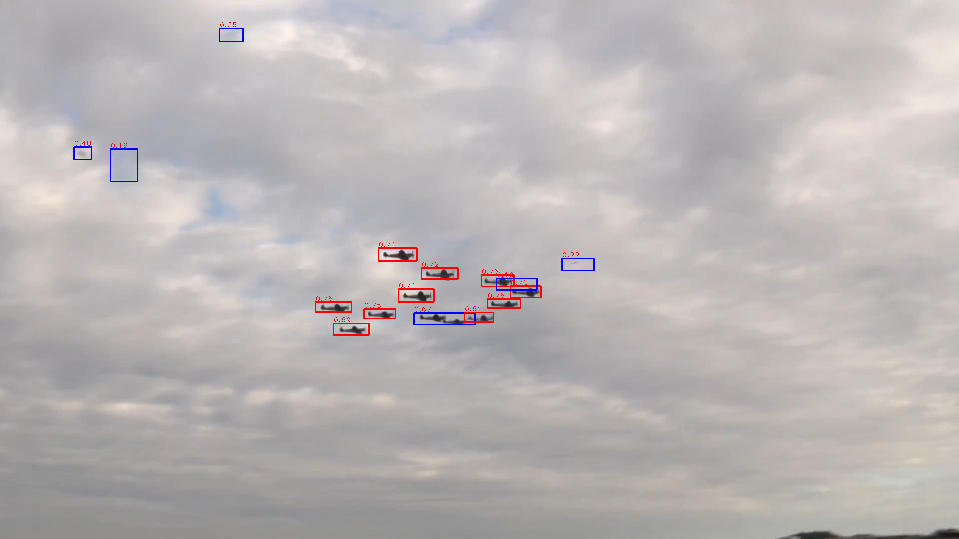
Clustering
Ori

Slide 9
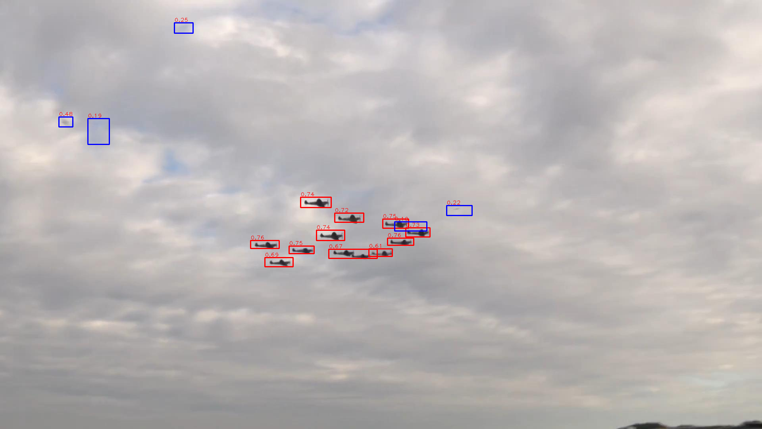
Clustering
Pred

Slide 10
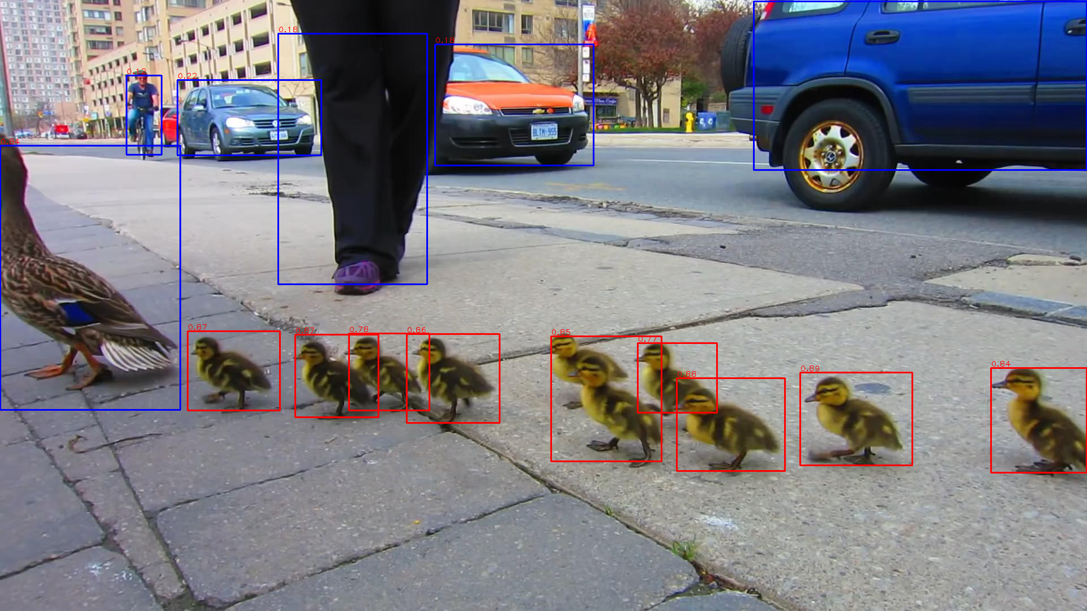
Clustering
Ori

Slide 11

Clustering
Pred

Slide 12
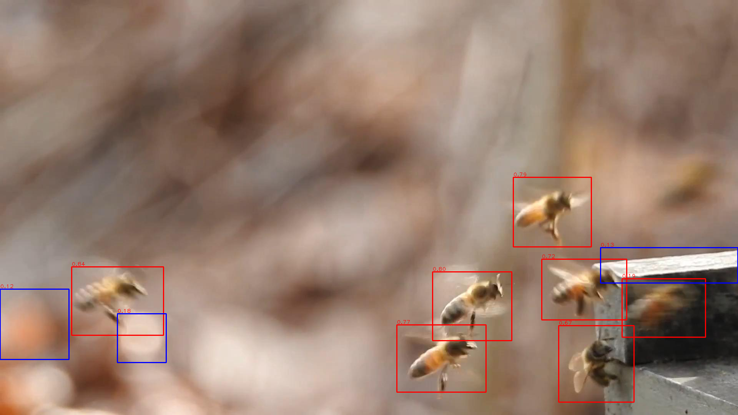
Clustering
Ori

Slide 13
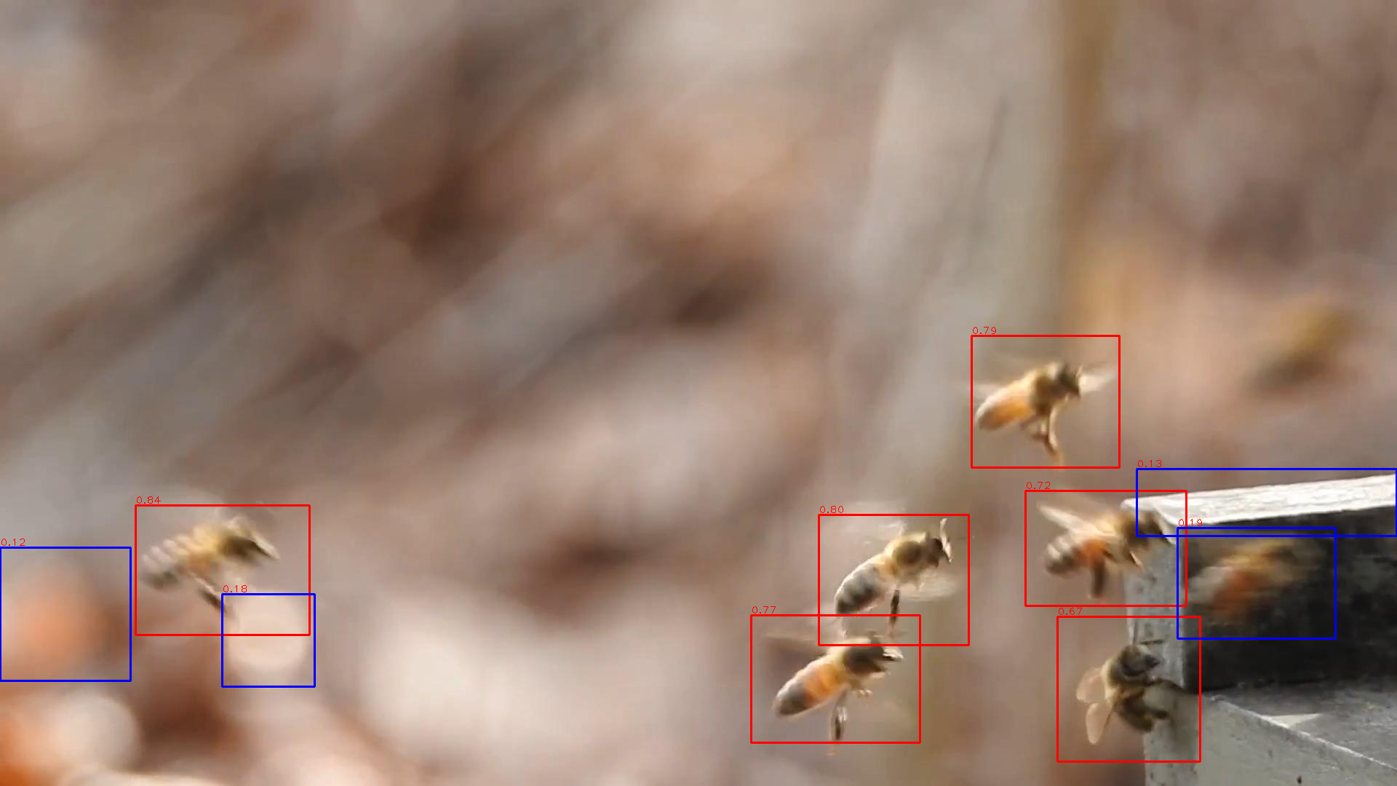
Clustering
Pred

Slide 14
End
End and Thanks!

